Slide 1
Creating a Pipeline with Python
Fall 2021

Slide 2
Create a Google account

Slide 3
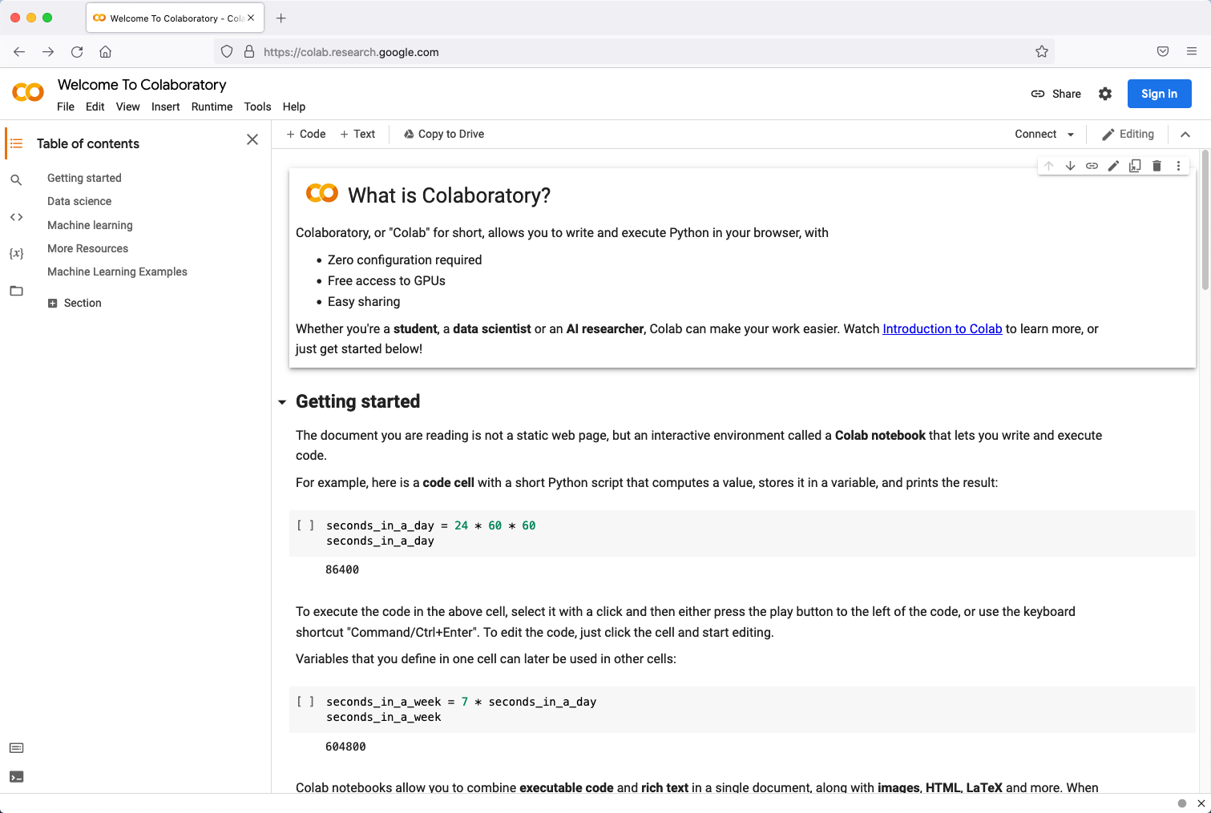
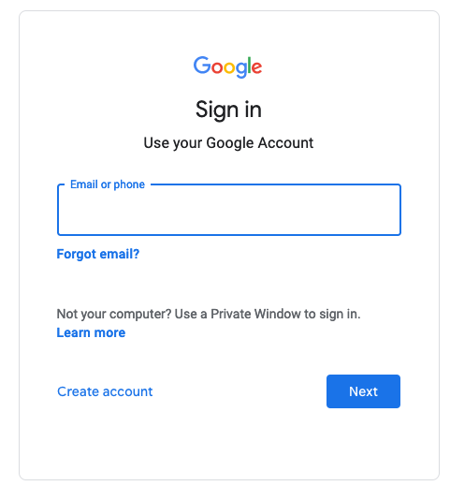
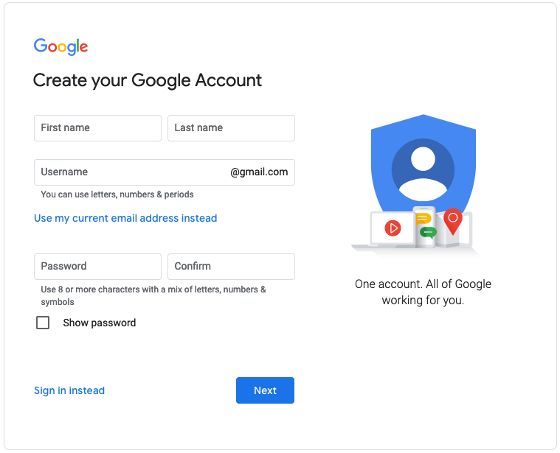
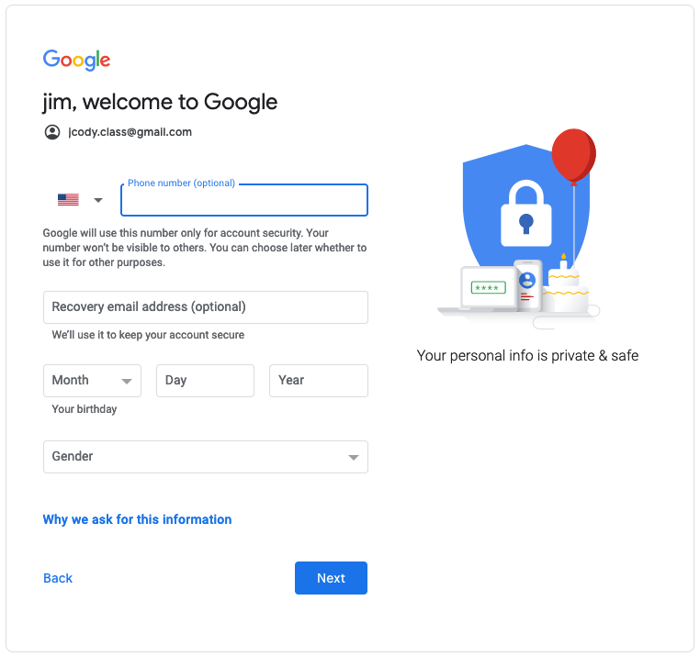
Create a google account
Start at https://colab.research.google.com/
Click on ‘Sign In’
Create account
On Create page, add username and pwd
Add final information
Go to Google CoLab!

Slide 4
Create a Kaggle account

Slide 5
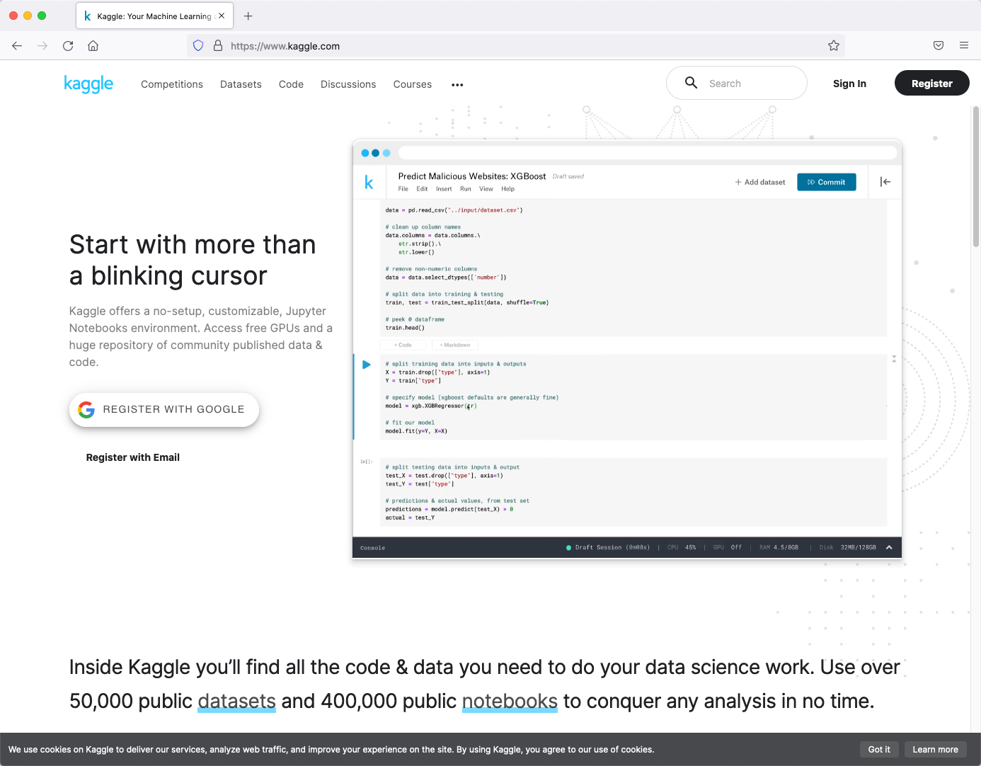
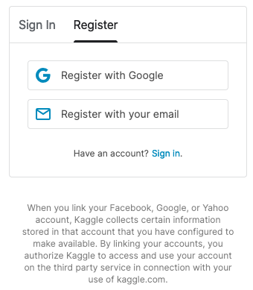
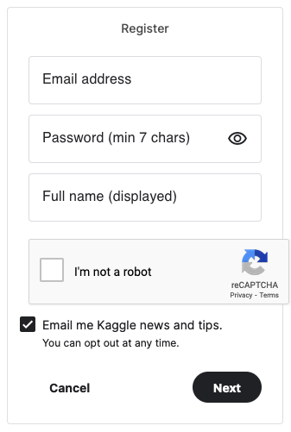
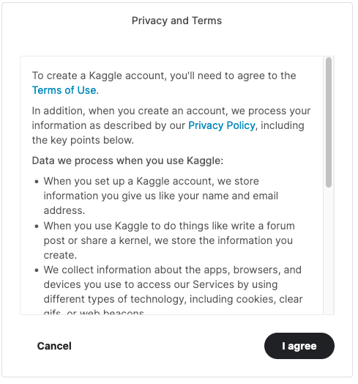
Create a Kaggle account

Slide 6
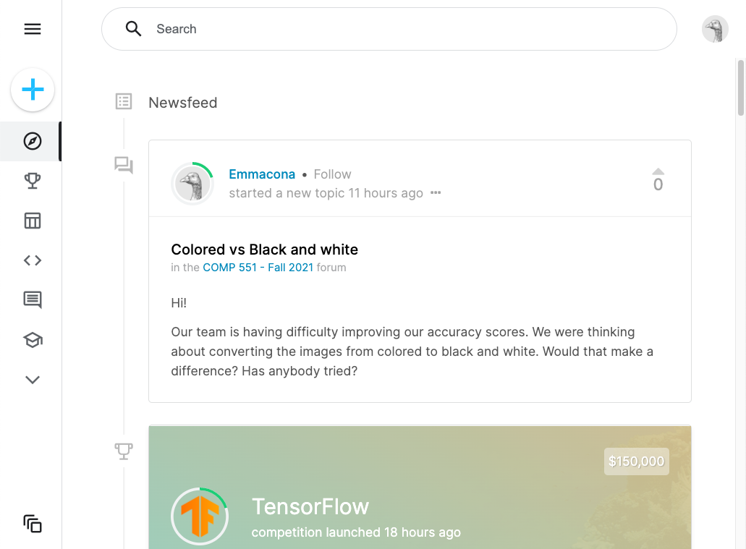
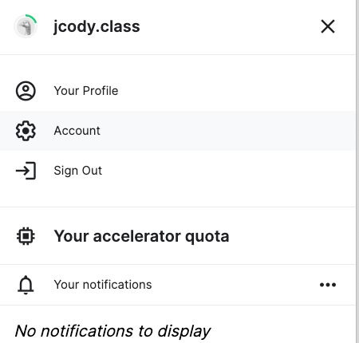
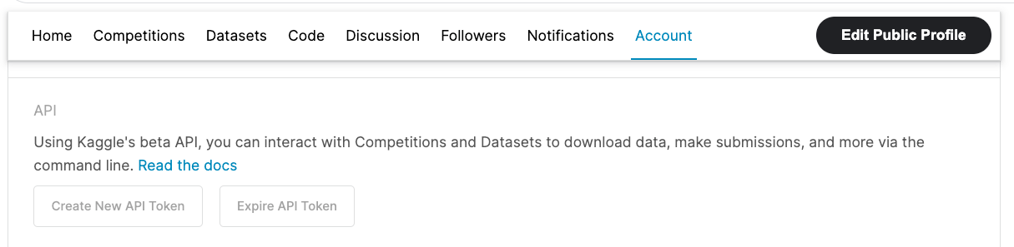
Get a Kaggle API Token
1
your name is here
2
3
After logging in, click on the icon at the top-right of the screen.
Select ‘Account’.
Scroll down on the Account page to ‘Create New API Token’.
Save the token. It will be saved as kaggle.json

